Slide 1
STS + Tomcat 7 Setup
razy.dev@gmail.com

Slide 2
STS + Tomcat 7 Setup
Setup Layout
Install APM + Tomcat 7
Set STS Configuration
Set Maven Deploy To Tomcat 7
Set MyBatis-Spring (MySQL)
부록
Annotation

Slide 3
I. Setup Layout
WorkEnv Layout
WorkSpace Layout
I.

Slide 4
1. WorkEnv Layout
I. Setup Layout
WorkEnv
Ex> C:/02.WorkEnv
0.Common
Maven
Maven conf + repository
ssh
tools
Ant, builder, debugger ...
1.APMT
APM_Setup + Tomcat
Server
Apache + PHP + MySQL + Tomcat
temp
users
WebDocs
신규 생성
2.AndroidStudio
3.EclipseADT
4.EclipseSTS
5.EclipsePHP

Slide 5
2. WorkSpace Layout
I. Setup Layout
WorkSpace
Ex> D:\3.WorkSpace
GridOneWeb
GridOneApp
GridOneAndroid

Slide 6
II. Install APM + Tomcat 7
Install Layout
Install APM_Setup
Install Tomcat 7
II.

Slide 7
1. Install Layout
II. Install APM + Tomcat 7
[YOUR_APMT_PATH]
Ex> WorkEnv/APMT
Server
Apache
Monitor
MySQL x
PHP x
phpMyAdmin
Tomcat 7.x
APM_Setup/Server 경로 아래에 설치
ZendOptimizer
temp
users
WebDocs
신규 생성
htdocs
Apache htdocs 경로 이동
webapps
Tomcat webapps 경로 이동 or 추가

Slide 8
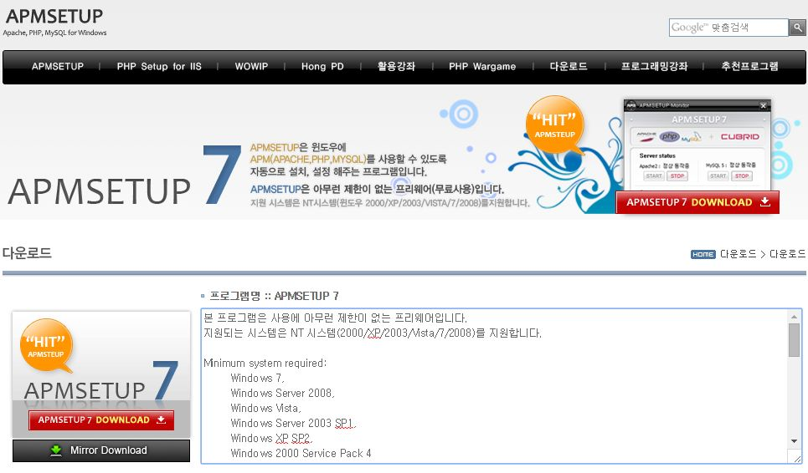
2. Install APM_Setup
II. Install APM + Tomcat 7

Slide 9
2. Install APM_Setup 2.1 Install APM_Setup
II. Install APM + Tomcat 7
2.1.1 Install APM_Setup
Download APM_Setup URL : http://www.apmsetup.com/download.php
Install APM_Setup INSTALL : [YOUR_APMT_PATH] ex> WorkEnv/APMT A : Apache P : PHP M : MySQL T : Tomcat

Slide 10
2. Install APM_Setup 2.2 Set Apache Configuration
II. Install APM + Tomcat 7
2.2.1 Set Apache DocumentRoot (Optional)
Apache 의 htdocs path 를 변경 할 경우 적용
Create Document Root CREATE : [YOUR_APMT_PATH]/WebDocs MOVE : [YOUR_APMT_PATH]/htdocs → [YOUR_APMT_PATH]/WebDocs/htdocs
Edit Apache Config EDIT : [APACHE_INSTALL_PATH]/conf/httpd.conf
... DocumentRoot "[YOUR_APMT_PATH]/WebDocs/htdocs“ ...

Slide 11
2. Install APM_Setup 2.3 Set MySQL Configuration
II. Install APM + Tomcat 7
2.3.1 Change MySQL Admin Password
SQL UPDATE ...

Slide 12
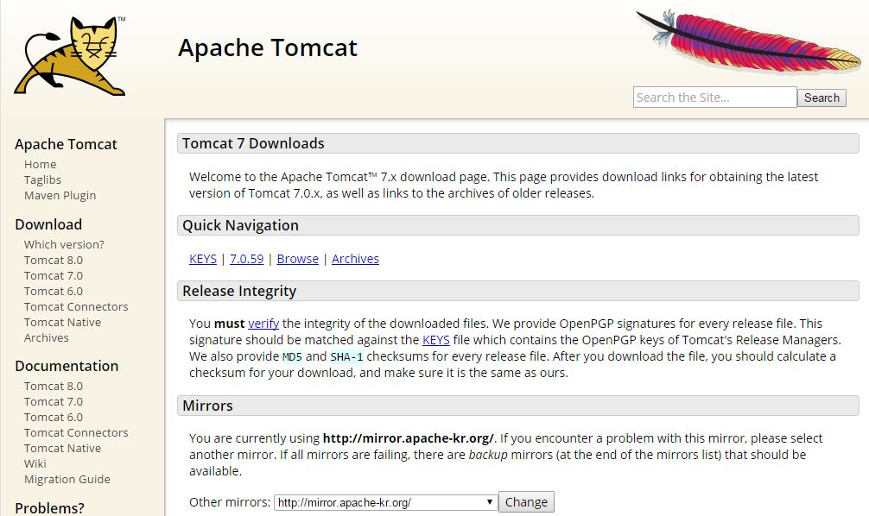
3. Install Tomcat 7
II. Install APM + Tomcat 7

Slide 13
3. Install Tomcat 7 3.1 Install Tomcat 7
II. Install APM + Tomcat 7
3.1.1 Install Tomcat 7
Download Tomcat 7 URL : http://tomcat.apache.org/download-70.cgi
Install Tomcat 7 INSTALL : [YOUR_APMT_PATH]/Server/Tomcat 7.x

Slide 14
3. Install Tomcat 7 3.2 Set Tomcat 7 Configuration
II. Install APM + Tomcat 7
Server
Listener +
GlobalNamingResources
Service +
Executor
Engine
Realm
Valve
Listener
Context (ROOT)
Wrapper +
Host 1 (localhost)
Realm
Valve
Listener
Context (Optional)
Connector HTTP
Wrapper +
Logger
Context (Optional)
Connector AJP
Wrapper +
Context (ROOT)
Connector HTTPS
Wrapper +
Host n (virtual host)
Realm
Valve
Listener
Context (Optional)
Wrapper +
Logger
Context (Optional)
Wrapper +

Slide 15
3. Install Tomcat 7 3.2 Set Tomcat 7 Configuration
II. Install APM + Tomcat 7
Server
Server tomcat instance
Service 한 개 이상의 Connector 를 통해 들어 오는 Request 를 Engine 으로 전달.
Engine Connector 를 통해 들어오는 Request 에 대한 실제 처리 블록.
Host Host Name 기반의 가상 호스트 설정. Host 는 1개 이상의 Context(web application)을 갖는다. (기본 ROOT)
Context (optional) 가상 호스트에서 실행 되는 실제 WebApplication 설정 정보. → /conf/Engine/Host/CONTEXT.xml 별도 파일에서 설정
Realm A Realm element represents a "database" of usernames, passwords, and roles.
Valve Log 설정 등.
Listener +
GlobalNamingResources
Service +
Connector HTTP
Connector AJP
Connector HTTPS
Executor
Engine
Realm
Valve
Listener
Host +
Realm
Valve
Listener
Context +
Wrapper +
Logger

Slide 16
3. Install Tomcat 7 3.2 Set Tomcat 7 Configuration
II. Install APM + Tomcat 7
/Conf
/Engine/host +
/Engine/Host
catalina.policy
ROOT.xml
<Context path="" docBase=“…” … />
catalina.properties
CONTEXT.xml +
context.xml
manager.xml
host-manager.xml
logging.properties
server.xml
/docBase
<Engine>
<Realm>
*.html
*.jsp
기타 web resource
<Host appBase=“..”> +
/WEB-INF/web.xml
tomcat-users.xml
<context>의 path 설정은 server.xml 이 static 설정 이고, <Host> 항목의 deployOnStartup 와 autoDeploy 가 모두 false 인 경우에만 적용 된다
<context>의 docBase 에서 설정된 경로가 appBase 하위 경로로 설정된 경우 docBase 설정값은 무시되며 CONTEXT.xml 파일명이 appBase 하위의 경로로 인식된다.
web.xml

Slide 17
3. Install Tomcat 7 3.2 Set Tomcat 7 Configuration
II. Install APM + Tomcat 7
3.2.1 Tomcat manager Admin
Set Tomcat manager ID/PW EDIT : [TOMCAT_INSTALL_PATH]/conf/tomcat-users.xml
... <role rolename="manager-gui" />
<role rolename="manager-script" />
<role rolename="manager-jmx" />
<role rolename="manager-status" />
<user username="admin" password="admin./" roles="manager-script, manager-gui" />
<!-- roles="manager-script, manager-gui, manager-jmx, manager-status" -->
...
Test Tomcat manager URL : http://localhost:8080/manager

Slide 18
3. Install Tomcat 7 3.2 Set Tomcat 7 Configuration
II. Install APM + Tomcat 7
3.2.2 Change or Create appBase (Optional)
Tomcat 의 기본 appBase 위치를 변경 하거나, 추가 할 경우
Add New Tomcat Service(Engine) Edit : [TOMCAT_INSTALL_PATH]/conf/server.xml
... <Service name=“[YOUR_SERVICE_NAME]">
<Connector port="9090" protocol="HTTP/1.1" connectionTimeout="20000" redirectPort="8443” URIEncoding="UTF-8" />
<Connector port="9009" protocol="AJP/1.3" redirectPort="8443" />
<Engine name="[YOUR_ENGINE_NAME]" defaultHost="localhost">
<Realm className="org.apache.catalina.realm.LockOutRealm">
<Realm className="org.apache.catalina.realm.UserDatabaseRealm" resourceName="UserDatabase"/>
</Realm>
<!– appBase 에서 지정한 경로와 /conf/[ENGINE_NAME]/[HOST_NAME] 설정 경로는 자동으로 생성 된다. -->
<Host name="localhost" appBase="[YOUR_PATH]/APMT/WebDocs/webapps/local" unpackWARs="true" autoDeploy="true" />
<Host name="abc.com" appBase="[YOUR_PATH]/APMT/WebDocs/webapps/abc" unpackWARs="true" autoDeploy="true" />
<Host ... />
</Engine>
</Service>
...

Slide 19
3. Install Tomcat 7 3.2 Set Tomcat 7 Configuration
II. Install APM + Tomcat 7
3.2.2 Change or Create appBase (Optional)
Add manager to New Tomcat Service(Engine) CREATE : [TOMCAT_INSTALL_PATH]/conf/[YOUR_ENGINE_NAME]/[HOST_NAME]/manager.xml
<!—
Tomcat 기본 manager application 을 새로 추가된 Host 에서 공용으로 사용 하도록 설정 한다.
-->
<Context docBase="${catalina.home}/webapps/manager" privileged="true" antiResourceLocking="false" />

Slide 20
3. Install Tomcat 7 3.2 Set Tomcat 7 Configuration
II. Install APM + Tomcat 7
3.2.3 Set UTF-8 : POST Encoding
Edit web.xml (또는 개별 webapplication 의 web.xml 에서 springframework의 CharacterEncodingFilter 설정 가능) Set Tomcat request and respons encodig EDIT : [TOMCAT_INSTALL_PATH]/conf/web.xml
... <!-- A filter that sets character encoding that is used to decode -->
<filter>
<filter-name>setCharacterEncodingFilter</filter-name>
<filter-class>org.apache.catalina.filters.SetCharacterEncodingFilter</filter-class>
<init-param>
<param-name>encoding</param-name>
<param-value>UTF-8</param-value>
</init-param>
<!-- init-param>
<param-name>forceEncoding</param-name>
<param-value>TRUE</param-value>
</init-param -->
<async-supported>true</async-supported>
</filter>
...
<filter-mapping>
<filter-name>Set Character Encoding</filter-name>
<url-pattern>/*</url-pattern>
</filter-mapping>
...

Slide 21
3. Install Tomcat 7 3.2 Set Tomcat 7 Configuration
II. Install APM + Tomcat 7
3.2.4 Set UTF-8 : URL(GET) Encoding
Edit server.xml EDIT : [TOMCAT_INSTALL_PATH]/conf/server.xml
... <Connector port="9090" protocol="HTTP/1.1" connectionTimeout="20000" redirectPort="8443" URIEncoding="UTF-8" />
<Connector port="9009" protocol="AJP/1.3" redirectPort="8443" URIEncoding="UTF-8" />
...
3.2.5 Set UTF-8 : File Encoding (optional)
Create setenv.sh Tomcat에서 처리하는 파일(java, jsp 등 소스 파일)의 Encoding 방식 적용 (본 문서에서는 모든 Encoding 을 UTF-8 로 설정 함) CREATE : [TOMCAT_INSTALL_PATH]/bin/setenv.sh
#!/bin/sh
JAVA_OPTS="$JAVA_OPTS -Dfile.encoding=\"utf-8\""

Slide 22
3. Install Tomcat 7 3.2 Set Tomcat 7 Configuration
II. Install APM + Tomcat 7
Set UTF-8 for Tomcat Web Application
Edit web.xml [TOMCAT_HOME]/conf/web.xml set org.apache.catalina.filters.SetCharacterEncodingFilter or [YOUR_WEB_APPLICATION]/WEB-INF/web.xml set org.springframework.web.filter.CharacterEncodingFilter
Set Server.xml (optional) <Connector port="8080" … URIEncoding="UTF-8" />
Set setenv.sh (optional) [TOMCAT_HOME]/bin/setenv.sh #!/bin/sh JAVA_OPTS="$JAVA_OPTS -Dfile.encoding=\"utf-8\""
Set JSP page set JSP Page : <%@ page pageEncoding="UTF-8" %>

Slide 23
III. Set STS Configuration
Install Plug-ins
Set Common Config
III.

Slide 24
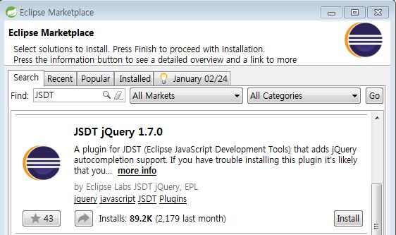
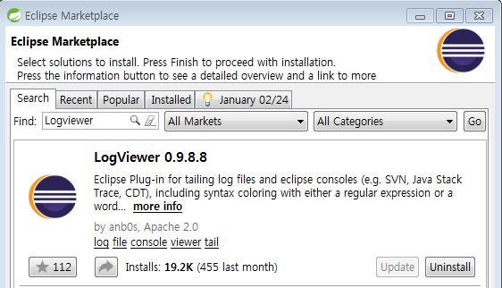
1. Install Plug-ins
III. Set STS Configuration
1.1 Install JSDT (JQuery)
[Help] - [Eclipse Marketplace]
FIND : JSDT
INSTALL : JSDT
1.2 Install LogViewer
[Help] - [Eclipse Marketplace]
FIND : LogViewer
INSTALL : LogViewer
Baretail 로 변경(무설치 Windows program) http://www.baremetalsoft.com/baretail/

Slide 25
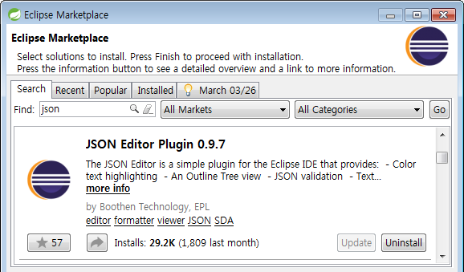
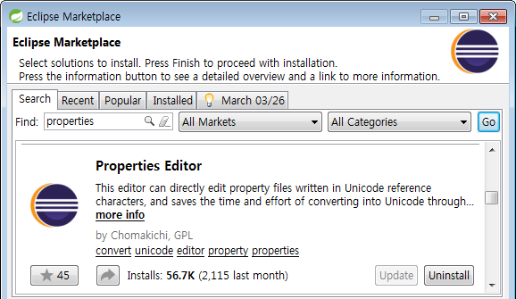
1. Install Plug-ins
III. Set STS Configuration
1.3 Install Json
[Help] - [Eclipse Marketplace]
FIND : json
INSTALL : json
1.4 Install Properties Editor
[Help] - [Eclipse Marketplace]
FIND : properties editor
INSTALL : properties editor

Slide 26
1. Install Plug-ins
III. Set STS Configuration
1.5 Install Subclipse
[Help] - [Eclipse Marketplace]
FIND : Subclipse
INSTALL : Subclipse

Slide 27
Eclipse + Spring Plugins
Eclipse
+ Spring
+ Subclipse

Slide 28
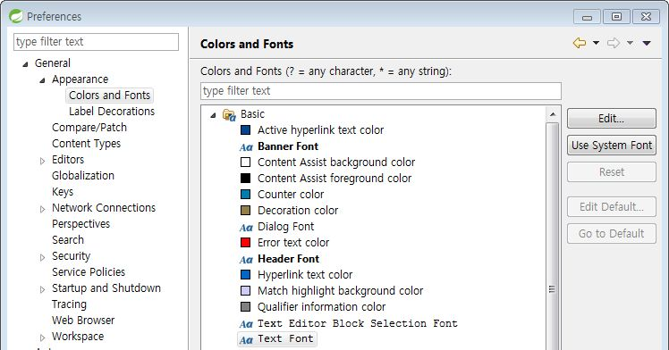
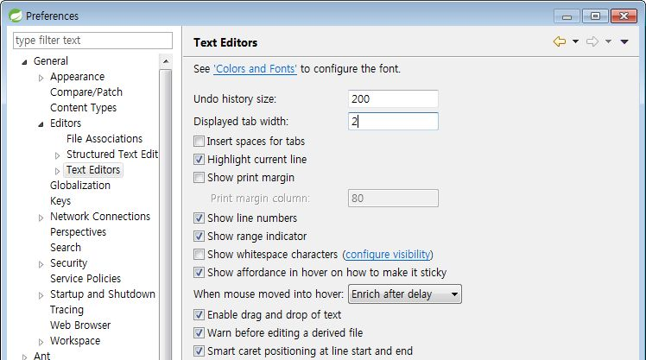
2. Set Common Config (1/3)
III. Set STS Configuration
2.1 Set Font
[Preferences]-[General]-[Appearance]-[Colors and Fonts]
[Basic] – [Text Font]
Set Font: Consols
2.2 Set Text Editors
[Preferences] - [General] - [Editors] - [Text Editors]
Display tab width: 2
Show line numbers: On
[Preferences] - [XML] - [XML Files] - [Editor]
Line width : 180
Split multiple attributes… : ON
Align final bracket in … : ON
Format comments Join Lines : Off

Slide 29
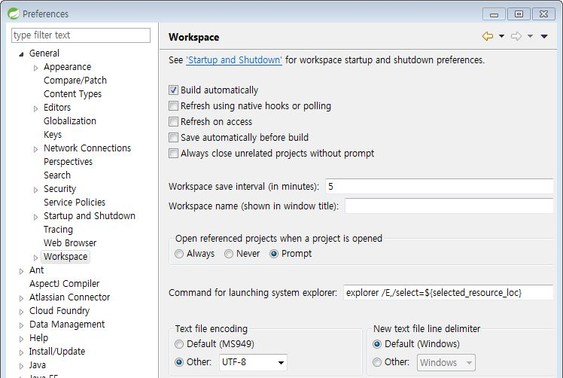
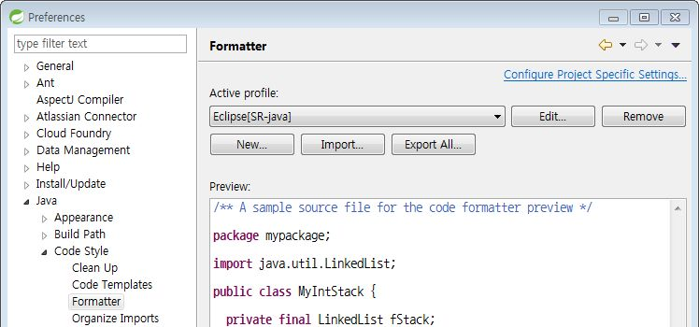
2. Set Common Config (2/3)
III. Set STS Configuration
2.3 Set UTF-8
[Preferences] - [General] - [Workspace]
Text file encoding: UTF-8
[Preferences] – [Web]
Text file encoding: UTF-8
2.4 Set Java Formatter
[Preferences] - [Java] - [Code Style] - [Formatter]
[Import]
Import ‘Eclipse Java’

Slide 30
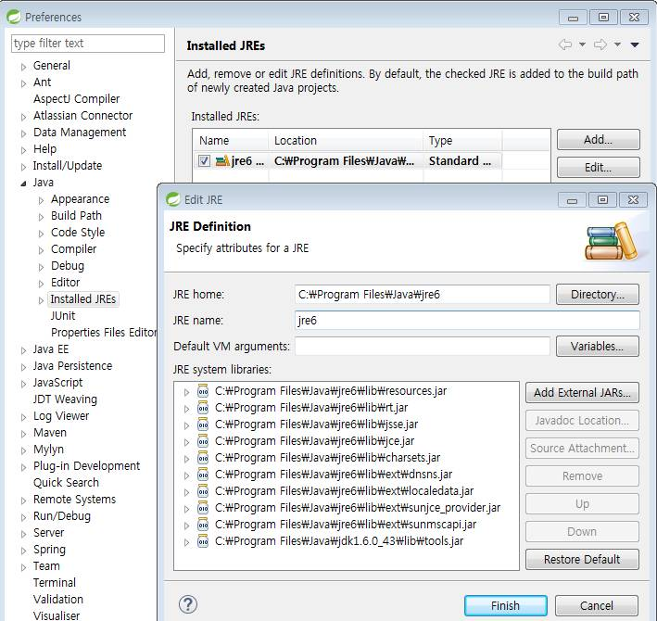
2. Set Common Config (3/3)
III. Set STS Configuration
2.5 Set tools.jar
[Preferences] - [Java] - [Install JREs] – [Edit]
[Add External JARs…]
[YOUR_JDK_PATH]/lib/tools.jar

Slide 31
IV. Set Maven Deploy To Tomcat 7
Set Maven Settings
Create STS Project
Set Maven Deploy
IV.

Slide 32
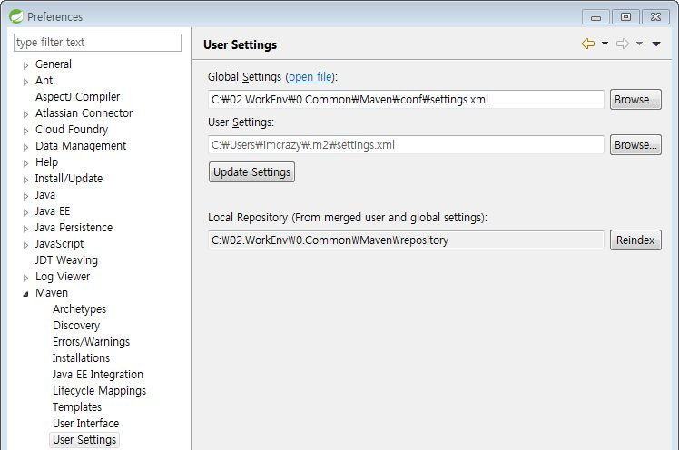
1. Set Maven Settings
IV. Set Maven Deploy To Tomcat 7
1.1 Set STS Maven Config
Create Maven Settings CRETE : [YOUR_MAVEN_PATH]/conf/settings.xml
<settings xmlns="http://maven.apache.org/SETTINGS/1.0.0"
xmlns:xsi="http://www.w3.org/2001/XMLSchema-instance"
xsi:schemaLocation="http://maven.apache.org/SETTINGS/1.0.0 http://maven.apache.org/xsd/settings-1.0.0.xsd">
<localRepository>[YOUR_MAVEN_PATH]/repository</localRepository>
</settings>
Set Maven Config
[Preferences] - [Maven] - [User Settings]
Global Settings : [YOUR_MAVEN_PATH]/conf/settings.xml
User Settings : [YOUR_MAVEN_PATH]/conf/settings.xml
→ [Update Settings]
[YOUR_MAVEN_PATH]
conf
Settings.xml
repository
...

Slide 33
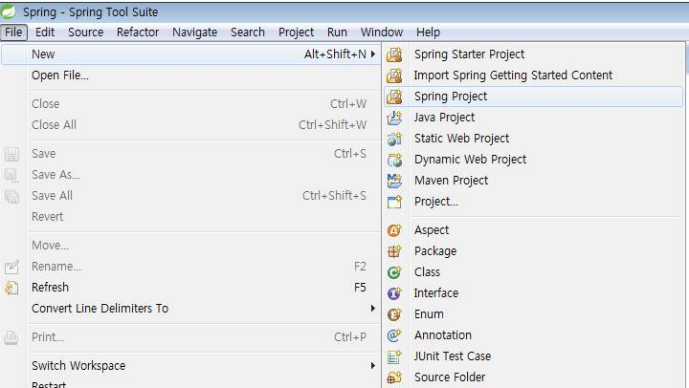
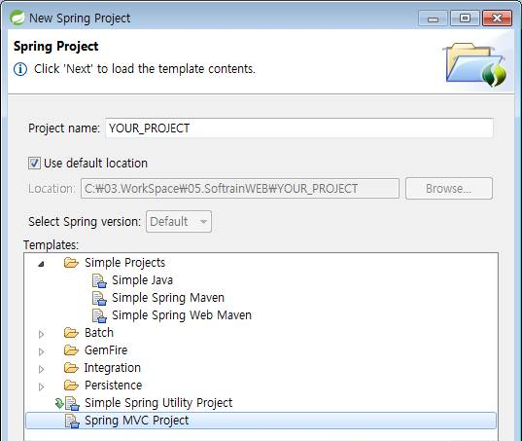
2. Create STS Project
IV. Set Maven Deploy To Tomcat 7
2.1 Create STS Project
[File] - [New] - [Spring Project]
Project Name : YOUR_PROJECT
Template : Spring MVC Project

Slide 34
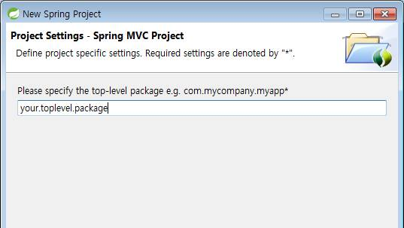
2. Create STS Project
IV. Set Maven Deploy To Tomcat 7
2.1 Create STS Project
Input Top-level Package Name
→ [Finish]

Slide 35
3. Set Maven Deploy
IV. Set Maven Deploy To Tomcat 7
3.1 Edit Maven Config (settings.xml)
Edit Maven Settings EDIT : [YOUR_MAVEN_PATH]/conf/settings.xml
<settings xmlns=http://maven.apache.org/settings/1.0.0
xmlns:xsi=http://www.w3.org/2001/XMLSchema-instance
xsi:schemaLocation="http://maven.apache.org/SETTINGS/1.0.0 http://maven.apache.org/xsd/settings-1.0.0.xsd">
<localRepository>[YOUR_MAVEN_PATH]/repository</localRepository>
<!-- Tomcat manager account 추가 -->
<servers>
<!-- Local Tomcat manager -->
<server>
<!--Maven Deploy 에서 사용할 고유 ID. Maven plug-in 설정에서 사용함. -->
<id>tomcat7</id>
<!-- Tomcat manager account 정보. tomcat-users.xml 에 설정과 동일 해야 함. -->
<username>admin</username>
<password>admin./</password>
</server>
</servers>
</settings>

Slide 36
3. Set Maven Deploy
IV. Set Maven Deploy To Tomcat 7
3.2 Edit Maven Config (pom.xml)
Edit Project Maven Config EDIT : [YOUR_PROJECT_HOME]/pom.xml
<project>
...
<build>
.....
<plugins>
.....
<!-- Deploy to Tomcat 7 -->
<plugin>
<groupId>org.apache.tomcat.maven</groupId>
<artifactId>tomcat7-maven-plugin</artifactId>
<version>2.2</version>
<configuration>
<url>http://[YOUR_TOMCAT_HOST]:xxxx/manager/text</url>
<server>tomcat7</server> <!-- settings.xml 에서 설정한 <id>tomcat7</id> -->
<!-- username>admin</username> <password>test</password -->
<path>/</path> <!-- Project 를 배포할 web application(Context) 경로 -->
<!-- Project 는 Tomcat Host 에 설정된 appBase 경로 아래로 배포 됨 -->
</configuration>
</plugin>
<!-- END : Deploy to Tomcat 7 -->
</plugins>
</build>
</project>

Slide 37
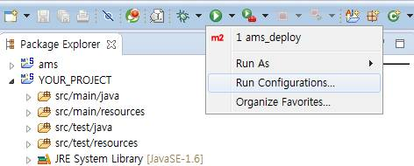
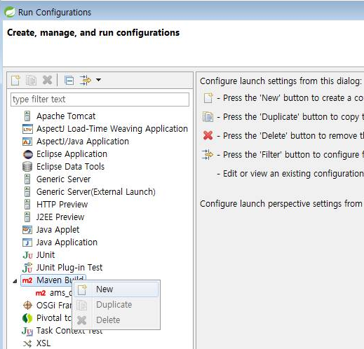
3. Set Maven Deploy
IV. Set Maven Deploy To Tomcat 7
3.3 Create Run Configurations…
[Run AS] – [Run Configurations…]
[Maven Build] – [New]

Slide 38
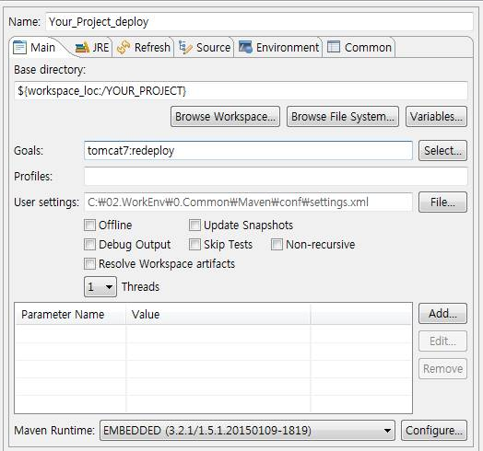
3. Set Maven Deploy
IV. Set Maven Deploy To Tomcat 7
3.3 Create Run Configurations…
Name : Maven Deploy Name
Base Directory : YOUR_PROJECT_PATH
Goals : clean:clean tomcat7:redeploy
→ [Apply] – [Run]

Slide 39
V. Set MyBatis-Spring (MySQL)
Overview
Set MySQL datasource
Set MyBatis-Spring
Set Log4jdbc
V.

Slide 40
1. Overview 1.1 Spring Project Layout (project config)
V. Set MyBatis-Spring (MySQL)
STS Project Layout
Web Service Layout
[PROJECT_HOME]
[WEB_HOME]
/PJT/conf
/PJT/conf
*.properties
/src/main
/ROOT
/java
/WEB-INF/classes
/java/** to /classes/**
TOP_LEVEL_PKG
TOP_LEVEL_PKG
/domain
Database VO, Model
/persistence
MyBatis interface & xml
/service
Service business logic
/controller
Spring Controllers
/util
Project utils (optional)
/resources
/META-INF
/META-INF
/resources/**
to /WEB-INF/classes/**
/config
/config
log4j.xml
log4j.xml
/webapp
/WEB-INF
/WEB-INF
/views
/views
/spring
/spring
/config
/config
/target
/css,/img,/js
/css,/img,/js
pom.xml
/META-INF

Slide 41
1. Overview 1.1 Spring Project Layout with lib (project repository)
V. Set MyBatis-Spring (MySQL)
STS Project Layout
Web Service Layout
[PROJECT_HOME]
[WEB_HOME]
lib
/src/main
/ROOT
/java
/WEB-INF/classes
/java/** to /classes/**
TOP_LEVEL_PKG
TOP_LEVEL_PKG
/domain
Database VO, Model
/persistence
MyBatis interface & xml
/service
Service business logic
/controller
Spring Controllers
/util
Project utils (optional)
/resources
/META-INF
/META-INF
/resources/**
to /WEB-INF/classes/**
/config
/config
log4j.xml
log4j.xml
/webapp
/WEB-INF
/WEB-INF
/views
/views
/spring
/spring
/config
/config
/target
/css,/img,/js
/css,/img,/js
pom.xml
/META-INF

Slide 42
1. Overview 1.2 Spring Configuration Layout (Type I : classpath:/config)
V. Set MyBatis-Spring (MySQL)
STS Project Layout
[PROJECT_HOME]
/src/main/PJT/conf
Project Local Config Path (optional)
jdbc.properties
/src/main/webapp
/resources
/META-INF
/config
web application config path
jdbc.properties
jdbc connection properties
local.properties
local(Server) env
context-datasource.xml
datasource config
context-mybatis.xml
MyBatis-Spring config
mybatis-config.xml
MyBatis base config
/values
menu, language, etc (optional)
log4j.xml
log4jdbc.properties
/webapp/WEB-INF
/spring
/appServlet
servlet-context.xml
root-context.xml
pom.xml
/config

Slide 43
1. Overview 1.2 Spring Configuration Layout (Type II : /WEB-INF/config)
V. Set MyBatis-Spring (MySQL)
STS Project Layout
[PROJECT_HOME]
/src/main/PJT/conf
Project Local Config Path (optional)
jdbc.properties
/src/main/webapp
/resources
/META-INF
web application config path
/config
/values
menu, language, etc (optional)
log4j.xml
log4jdbc.properties
/webapp/WEB-INF
/spring
/appServlet
servlet-context.xml
root-context.xml
/config
jdbc.properties
jdbc connection properties
local.properties
local(Server) env
context-datasource.xml
datasource config
context-mybatis.xml
MyBatis-Spring config
pom.xml
mybatis-config.xml
MyBatis base config

Slide 44
1. Overview 1.3 Spring Configuration Relation (Type 1)
V. Set MyBatis-Spring (MySQL)
[classpath:/config/jdbc.properties]
jdbc.driver = com.mysql.jdbc.Driver
jdbc.url = jdbc:mysql://localhost:3306
jdbc.username = learn
jdbc.password = learn./
[classpath:/config/context-datasource.xml (OR datasource-context.xml)]
<util:properties id="db" location="classpath:/config/jdbc.properties" />
<bean id="dataSource" class="org.apache.commons.dbcp.BasicDataSource" ... >
<property name="driverClassName" value="#{db['jdbc.driver']}" />
<property name="url" value="#{db['jdbc.url']}" />
<property name="username" value="#{db['jdbc.username']}" />
<property name="password" value="#{db['jdbc.password']}" />
</bean>
[WEB-INF/spring/root-context.xml]
<import resource="classpath:/config/context-datasource.xml"/>
<import resource="classpath:/config/context-mybatis.xml" />
[classpath:/config/context-mybatis.xml (OR mybatis-context.xml)]
<bean id="sqlSessionFactory" class="org.mybatis.spring.SqlSessionFactoryBean">
<property name="dataSource" ref="dataSource" />
<property name="configLocation" value="classpath:/config/mybatis-config.xml" />
</bean>
[classpath:/config/mybatis-config.xml]
<configuration>
<settings> ... </settings>
<typeHandlers> ... </typeHandlers>
</configuration>

Slide 45
1. Overview 1.3 Spring Configuration Relation (Type 2)
V. Set MyBatis-Spring (MySQL)
[classpath:/config/local.properties]
local.home= ${local.home}
local.conf= ${local.home}/PJT/conf
[PJT/conf/jdbc.properties]
jdbc.driver = com.mysql.jdbc.Driver
jdbc.url = jdbc:mysql://localhost:3306
jdbc.username = learn
jdbc.password = learn./
[classpath:/config/context-datasource.xml]
<util:properties id="local" location="classpath:/config/local.properties" />
<util:properties id="db" location="file:#{local['local.conf']}/jdbc.properties" />
<bean id="dataSource" class="org.apache.commons.dbcp.BasicDataSource" ... >
<property name="driverClassName" value="#{db['jdbc.driver']}" />
<property name="url" value="#{db['jdbc.url']}" />
<property name="username" value="#{db['jdbc.username']}" />
<property name="password" value="#{db['jdbc.password']}" />
</bean>
[WEB-INF/spring/root-context.xml]
<import resource="classpath:/config/context-datasource.xml"/>
<import resource="classpath:/config/context-mybatis.xml" />
[classpath:/config/context-mybatis.xml]
<bean id="sqlSessionFactory" class="org.mybatis.spring.SqlSessionFactoryBean">
<property name="dataSource" ref="dataSource" />
<property name="configLocation" value="classpath:/config/mybatis-config.xml" />
</bean>
[classpath:/config/mybatis-config.xml]
<configuration>
<settings> ... </settings>
<typeHandlers> ... </typeHandlers>
</configuration>

Slide 46
2. Set MySQL datasource
V. Set MyBatis-Spring (MySQL)
2.1 Set MySQL dependency (via Maven)
Add MySQL lib by Maven EDIT : [YOUR_PROJECT_HOME]/pom.xml
<dependency> <!-- Spring JDBC -->
<groupId>org.springframework</groupId>
<artifactId>spring-jdbc</artifactId>
<version>${org.springframework-version}</version>
</dependency>
<dependency> <!-- MySQL Conn Lib -->
<groupId>mysql</groupId>
<artifactId>mysql-connector-java</artifactId>
<version>5.1.31</version>
</dependency>
<dependency> <!-- DB Connection Pool -->
<groupId>commons-dbcp</groupId>
<artifactId>commons-dbcp</artifactId>
<version>1.4</version>
</dependency>
<dependency> <!-- Optional -->
<groupId>commons-lang</groupId>
<artifactId>commons-lang</artifactId>
<version>2.6</version>
</dependency>

Slide 47
2. Set MySQL datasource
V. Set MyBatis-Spring (MySQL)
2.2 Set JDBC Properties
Define Database connection information CREATE : [YOUR_PROJECT_HOME]/src/main/resource/config/jdbc.properties
# jdbc.driver = [JDBC_DRIVER_NAME]
jdbc.driver = com.mysql.jdbc.Driver
# jdbc.url = jdbc:mysql://[YOUR_DB_HOST]:[YOUR_DB_PORT]/[YOUR_DB_NAME(SID)]?[OPTION]
jdbc.url = jdbc:mysql://localhost:3306/learn
# jdbc.account
jdbc.username = [YOUR_DB_ACCOUNT]
jdbc.password = [YOUR_DB_PASSWD]

Slide 48
2. Set MySQL datasource
V. Set MyBatis-Spring (MySQL)
2.3 Set Datasource
Define datasource CREATE : [YOUR_PROJECT_HOME]/src/main/resource/config/context-datasource.xml
<?xml version="1.0" encoding="UTF-8"?>
<beans xmlns="http://www.springframework.org/schema/beans"
xmlns:xsi="http://www.w3.org/2001/XMLSchema-instance"
xmlns:util="http://www.springframework.org/schema/util"
xsi:schemaLocation="http://www.springframework.org/schema/beans http://www.springframework.org/schema/beans/spring-beans.xsd
http://www.springframework.org/schema/util http://www.springframework.org/schema/util/spring-util-3.2.xsd"
>
<!– 2.2 에서 설정한 jdbc.properties 를 읽어온다. (참고 URL 참조) -->
<util:properties id="db" location="classpath:/config/jdbc.properties" />
<!– Jakarta dbcp DBCP(Jakarta Commons Database Connection Pool) API 을 이용한 conection pool 구성 -->
<bean id="dataSource" class="org.apache.commons.dbcp.BasicDataSource" destroy-method="close">
<property name="driverClassName" value="#{db['jdbc.driver']}" />
<property name="url" value="#{db['jdbc.url']}" />
<property name="username" value="#{db['jdbc.username']}" />
<property name="password" value="#{db['jdbc.password']}" />
</bean>
<!– Spring transactionManager 설정 -->
<bean id="transactionManager" class="org.springframework.jdbc.datasource.DataSourceTransactionManager">
<property name="dataSource" ref="dataSource" />
</bean>
</beans>
http://aid.altibase.com/pages/viewpage.action?pageId=7340956
http://www.baeldung.com/2012/02/06/properties-with-spring/
http://mryong8.blogspot.kr/2014/11/spring-32-properties-java-jsp-xml.html

Slide 49
2. Set MySQL datasource
V. Set MyBatis-Spring (MySQL)
2.4 Add Datasource to Spring
Add datasource MODIFY : [YOUR_PROJECT_HOME]/src/main/webapp/WEB-INF/spring/root-context.xml
<?xml version="1.0" encoding="UTF-8"?>
<beans xmlns="http://www.springframework.org/schema/beans"
xmlns:xsi="http://www.w3.org/2001/XMLSchema-instance"
xsi:schemaLocation="http://www.springframework.org/schema/beans http://www.springframework.org/schema/beans/spring-beans.xsd">
<!-- Root Context: defines shared resources visible to all other web components -->
<import resource="classpath:/config/context-datasource.xml"/>
</beans>

Slide 50
3. Set MyBatis-Spring
V. Set MyBatis-Spring (MySQL)
3.1 Set MyBatis-Spring dependency (via Maven)
Add MyBatis-Spring lib by Maven EDIT : [YOUR_PROJECT_HOME]/pom.xml
<dependency> <!-- MyBatis -->
<groupId>org.mybatis</groupId>
<artifactId>mybatis</artifactId>
<version>3.2.2</version>
</dependency>
<dependency> <!-- MyBatis - Spring -->
<groupId>org.mybatis</groupId>
<artifactId>mybatis-spring</artifactId>
<version>1.2.2</version>
</dependency>

Slide 51
3. Set MyBatis-Spring
V. Set MyBatis-Spring (MySQL)
3.2 Set MyBatis-Spring
Define MyBatis-Spring CREATE : [YOUR_PROJECT_HOME]/src/main/resource/config/context-mybatis.xml
<?xml version="1.0" encoding="UTF-8"?>
<beans xmlns="http://www.springframework.org/schema/beans"
xmlns:xsi="http://www.w3.org/2001/XMLSchema-instance"
xmlns:util="http://www.springframework.org/schema/util"
xmlns:context="http://www.springframework.org/schema/context"
xmlns:mybatis="http://mybatis.org/schema/mybatis-spring"
xsi:schemaLocation="http://www.springframework.org/schema/beans http://www.springframework.org/schema/beans/spring-beans-3.1.xsd
http://www.springframework.org/schema/util http://www.springframework.org/schema/util/spring-util-3.1.xsd
http://www.springframework.org/schema/context http://www.springframework.org/schema/context/spring-context-3.1.xsd
http://mybatis.org/schema/mybatis-spring http://mybatis.org/schema/mybatis-spring.xsd"
>
<bean id="sqlSessionFactory" class="org.mybatis.spring.SqlSessionFactoryBean">
<property name="dataSource" ref="dataSource" />
<property name="configLocation" value="classpath:/config/mybatis-config.xml" />
<!-- property name="mapperLocations">
<list><value>classpath*:/net/xyz/learn/persistence/*Mapper.xml</value></list>
</property -->
</bean>
<!-- scan for mappers(mapper.xml) and let them be autowired -->
<mybatis:scan base-package="net.xyz.learn.persistence" />
<!-- bean class="org.mybatis.spring.mapper.MapperScannerConfigurer">
<property name="basePackage" value="net.xyz.learn.persistence" />
<property name="annotationClass" value="org.springframework.stereotype.Repository" />
</bean -->
</beans>
http://mybatis.github.io/spring/ko/mappers.html#register

Slide 52
3. Set MyBatis-Spring
V. Set MyBatis-Spring (MySQL)
3.3 Set MyBatis config (optioal)
define MyBatis config CREATE : [YOUR_PROJECT_HOME]/src/main/resource/config/mybatis-config.xml
<?xml version="1.0" encoding="UTF-8" ?>
<!DOCTYPE configuration PUBLIC "-//mybatis.org//DTD Config 3.0//EN" "http://mybatis.org/dtd/mybatis-3-config.dtd">
<configuration>
<!-- settings>
<setting name="cacheEnabled" value="true" />
<setting name="lazyLoadingEnabled" value="true" />
<setting name="multipleResultSetsEnabled" value="true" />
<setting name="useColumnLabel" value="true" />
<setting name="useGeneratedKeys" value="false" />
<setting name="autoMappingBehavior" value="PARTIAL" />
<setting name="defaultExecutorType" value="SIMPLE" />
<setting name="defaultStatementTimeout" value="25" />
<setting name="safeRowBoundsEnabled" value="false" />
<setting name="mapUnderscoreToCamelCase" value="false" />
<setting name="localCacheScope" value="SESSION" />
<setting name="jdbcTypeForNull" value="OTHER" />
<setting name="lazyLoadTriggerMethods" value="equals,clone,hashCode,toString" />
</settings -->
<!-- typeAliases>
<typeAlias alias="Author" type="domain.blog.Author"/>
<typeAlias alias="Blog" type="domain.blog.Blog"/>
<typeAlias alias="Comment" type="domain.blog.Comment"/>
<typeAlias alias="Post" type="domain.blog.Post"/>
<typeAlias alias="Section" type="domain.blog.Section"/>
<typeAlias alias="Tag" type="domain.blog.Tag"/>
</typeAliases -->
<!-- java.sql.Timestamp 를 java.util.Date 형으로 반환 or set User Type -->
<!-- typeHandlers>
<typeHandler javaType="java.sql.Timestamp" handler="org.apache.ibatis.type.DateTypeHandler" />
<typeHandler javaType="java.sql.Time" handler="org.apache.ibatis.type.DateTypeHandler" />
<typeHandler javaType="java.sql.Date" handler="org.apache.ibatis.type.DateTypeHandler" />
</typeHandlers -->
</configuration>
http://mybatis.github.io/mybatis-3/ko/configuration.html#properties

Slide 53
3. Set MyBatis-Spring
V. Set MyBatis-Spring (MySQL)
3.4 Add MyBatis to Spring
Add MyBatis MODIFY : [YOUR_PROJECT_HOME]/src/main/webapp/WEB-INF/spring/root-context.xml
<?xml version="1.0" encoding="UTF-8"?>
<beans xmlns="http://www.springframework.org/schema/beans"
xmlns:xsi="http://www.w3.org/2001/XMLSchema-instance"
xsi:schemaLocation="http://www.springframework.org/schema/beans http://www.springframework.org/schema/beans/spring-beans.xsd">
<!-- Root Context: defines shared resources visible to all other web components -->
<import resource="classpath:/config/context-datasource.xml"/>
<import resource="classpath:/config/context-mybatis.xml" />
</beans>

Slide 54
4. Set Log4jdbc
V. Set MyBatis-Spring (MySQL)
4.1 Set Log4jdbc dependency (via Maven)
Add Log4jdbc lib by Maven EDIT : [YOUR_PROJECT_HOME]/pom.xml
<dependency>
<groupId>com.googlecode.log4jdbc</groupId>
<artifactId>log4jdbc</artifactId>
<version>1.2</version>
</dependency>
https://code.google.com/p/log4jdbc/

Slide 55
4. Set Log4jdbc
V. Set MyBatis-Spring (MySQL)
4.2 Modify jdbc.properties for Log4jdbc
Define jdbc Database connection information EDIT : [YOUR_PROJECT_HOME]/src/main/resource/config/jdbc.properties
# jdbc.driver = [JDBC_DRIVER_NAME]
jdbc.driver = com.mysql.jdbc.Driver # 사용자 선택에 따름
jdbc.log4j.driver = net.sf.log4jdbc.DriverSpy # 반드시 이 driver 만 사용 해야 함
# jdbc.url = jdbc:mysql://[YOUR_DB_HOST]:[YOUR_DB_PORT]/[YOUR_DB_NAME(SID)]?[OPTION]
jdbc.url = jdbc:mysql://localhost:3306/learn
jdbc.log4j.url = jdbc:log4jdbc:mysql://localhost:3306/learn
# jdbc.account
jdbc.username = [YOUR_DB_ACCOUNT]
jdbc.password = [YOUR_DB_PASSWD]

Slide 56
4. Set Log4jdbc
V. Set MyBatis-Spring (MySQL)
4.3 Modify Datasource Log4jdbc
Define datasource CREATE : [YOUR_PROJECT_HOME]/src/main/resource/config/context-datasource.xml
<?xml version="1.0" encoding="UTF-8"?>
<beans xmlns="http://www.springframework.org/schema/beans"
xmlns:xsi="http://www.w3.org/2001/XMLSchema-instance"
xmlns:util="http://www.springframework.org/schema/util"
xsi:schemaLocation="http://www.springframework.org/schema/beans http://www.springframework.org/schema/beans/spring-beans.xsd
http://www.springframework.org/schema/util http://www.springframework.org/schema/util/spring-util-3.2.xsd"
>
<!– 2.2 에서 설정한 jdbc.properties 를 읽어온다. (참고 URL 참조) -->
<util:properties id="db" location="classpath:/config/jdbc.properties" />
<!– Jakarta dbcp DBCP(Jakarta Commons Database Connection Pool) API 을 이용한 conection pool 구성 -->
<bean id="dataSource" class="org.apache.commons.dbcp.BasicDataSource" destroy-method="close">
<property name="driverClassName" value="#{db['jdbc.log4j.driver']}" /> <!– net.sf.log4jdbc.DriverSpy 적용 -->
<property name="url" value="#{db['jdbc.log4j.url']}" /> <!– jdbc:log4jdbc:... 적용 -->
<property name="username" value="#{db['jdbc.username']}" />
<property name="password" value="#{db['jdbc.password']}" />
</bean>
<!– Spring transactionManager 설정 -->
<bean id="transactionManager" class="org.springframework.jdbc.datasource.DataSourceTransactionManager">
<property name="dataSource" ref="dataSource" />
</bean>
</beans>

Slide 57
4. Set Log4jdbc
V. Set MyBatis-Spring (MySQL)
4.4 Set Log4jdbc logger at log4.xml
Set log4jdbc logger EDIT : [YOUR_PROJECT_HOME]/src/main/resource/log4j.xml
<logger name="jdbc.connection" additivity="false">
<level value="INFO" />
<appender-ref ref="console" />
</logger>
<logger name="jdbc.audit" additivity="false">
<level value="OFF" />
<appender-ref ref="console" />
</logger>
<logger name="jdbc.sqlonly" additivity="false">
<level value="OFF" />
<appender-ref ref="console" />
</logger>
<logger name="jdbc.sqltiming" additivity="false">
<level value="DEBUG" />
<appender-ref ref="console" />
</logger>
<logger name="jdbc.resultset" additivity="false">
<level value="OFF" />
<appender-ref ref="console" />
</logger>
<logger name="jdbc.resultsettable" additivity="false">
<level value="OFF" />
<appender-ref ref="console" />
</logger>
<!-- debug logging for log4jdbc itself -->
<logger name="log4jdbc.debug" additivity="false">
<level value="DEBUG" />
<appender-ref ref="console" />
</logger>
https://github.com/alewando/log4jdbc/blob/master/doc/log4j.xml

Slide 58
4. Set Log4jdbc
V. Set MyBatis-Spring (MySQL)
4.5 Set Log4jdbc properties (optional)
Define log4jdbc properties CREATE : [YOUR_PROJECT_HOME]/src/main/resource/log4jdbc.properties (위치 변경 불가)
# log4jdbc.debug.stack.prefix
# log4jdbc.sqltiming.warn.threshold
# log4jdbc.sqltiming.error.threshold
# log4jdbc.dump.booleanastruefalse
log4jdbc.dump.sql.maxlinelength = 0 # SQL log 줄 바꿈 설정
# log4jdbc.dump.fulldebugstacktrace
# log4jdbc.statement.warn
# log4jdbc.dump.sql.select
# log4jdbc.dump.sql.insert
# log4jdbc.dump.sql.update
# log4jdbc.dump.sql.delete
# log4jdbc.dump.sql.create
# log4jdbc.dump.sql.addsemicolon
# log4jdbc.auto.load.popular.drivers
# log4jdbc.trim.sql
# log4jdbc.trim.sql.extrablanklines
# log4jdbc.suppress.generated.keys.exception
log4jdbc.drivers = com.mysql.jdbc.Driver # 설정 적용 여부 미확인
https://code.google.com/p/log4jdbc/

Slide 59
부록
Add Custom Library to Maven
Add jackson Library
Add lombok Library
Annotation
Spring properties
VI.

Slide 60
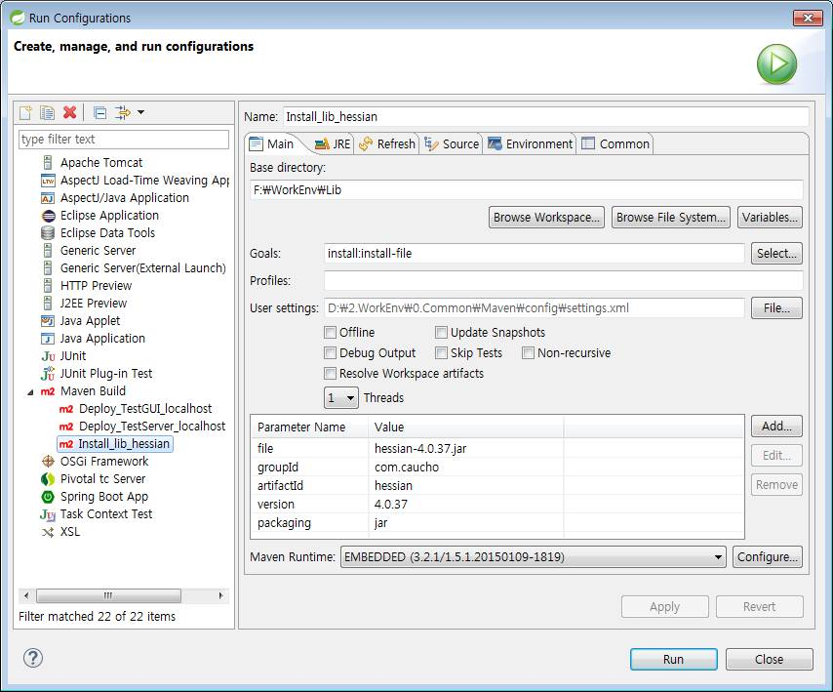
1. Add Custom Library to Maven
VI. 부록
1.1 Add custom lib to maven repository
Name : 적당히
Base Directory : jar 파일 경로 지정 (Browse File System)
Goals : install:install-file
Parameters file jira-soap-5.0.0.jar groupId org.swift.common artifactId jira-soap version 5.0.0 packaging jar

Slide 61
1. Add Custom Library to Maven
V. Set MyBatis-Spring (MySQL)
1.2 Add Maven dependency
Add Maven dependency EDIT : [YOUR_PROJECT_HOME]/pom.xml
...
<dependency>
<groupId>org.swift.common</groupId>
<artifactId>jira-soap</artifactId>
<version>5.0.0</version>
</dependency>
...
61
http://lng1982.tistory.com/202

Slide 62
2. Add Jackson Library
VI. 부록
2.1 Add Jackson library

Slide 63
3. Add Lombok Library
VI. 부록
3.1 Add lombok library

Slide 64
Java Annotation
http://www.nextree.co.kr/p5864/
http://kang594.blog.me/39704853
http://secretroute.tistory.com/entry/%EC%9E%90%EB%B0%94%EC%9D%98%E7%A5%9E-Vol1-Annotation

Slide 65
Spring Annotation
http://interwater.tistory.com/entry/Spring-%EC%96%B4%EB%85%B8%ED%85%8C%EC%9D%B4%EC%85%98
http://www.egovframe.go.kr/wiki/doku.php?id=egovframework:rte2:ptl:annotation-based_controller
http://noritersand.tistory.com/156
@Bean and @Configuration
@Required
@Autowired @Qualifier
@Resource
@PostConstruct and @PreDestroy
@Component
@Component, @Repository, @Service, and @Controller
@Inject and @Named
@Scope and scoped-proxy
Spring | javax.inject.* | javax.inject restrictions / comments
@Autowired | @Inject | @Inject has no 'required' attribute
@Component | @Named | —
@Scope("singleton") | @Singleton | The JSR-330 default scope is like Spring's prototype. However, in order to keep it consistent with Spring's general defaults, a JSR-330 bean declared in the Spring container is a singleton by default. In order to use a scope other thansingleton, you should use Spring's @Scope annotation. javax.inject also provides a @Scope annotation. Nevertheless, this one is only intended to be used for creating your own annotations.
@Qualifier | @Named | —
@Value | — | no equivalent
@Required | — | no equivalent
@Lazy | — | no equivalent

Slide 66
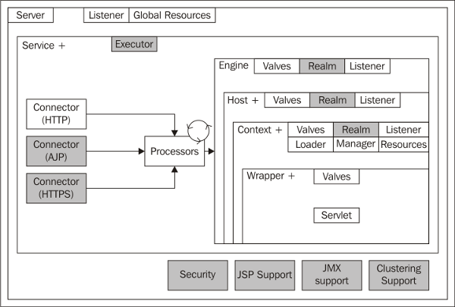
[conf/server.xml]

Slide 67
1. Spring Project Layout
V. Set MyBatis-Spring (MySQL)
STS Project Layout
Web Service Layout
[PROJECT_HOME]
[WEB_HOME]
/PJT/conf
*.properties
/PJT/conf
/src/main
/ROOT
/java
/java to /classes
/WEB-INF/classes
TOP_LEVEL_PKG
TOP_LEVEL_PKG
/domain
Database VO, Model
/persistence
MyBatis interface & xml
/service
Service business logic
/controller
Spring Controllers
/util
Project utils (optional)
/resources
/resources/** to /WEB-INF/classes/**
/META-INF
/META-INF
log4j.xml
log4j.xml
/webapp
/WEB-INF
/WEB-INF
/views
/views
/spring
/spring
/target
/css,/img,/js
/css,/img,/js
pom.xml
/META-INF

